Slide 1

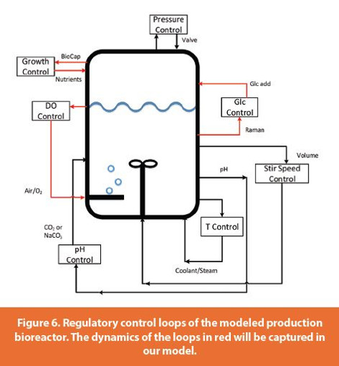
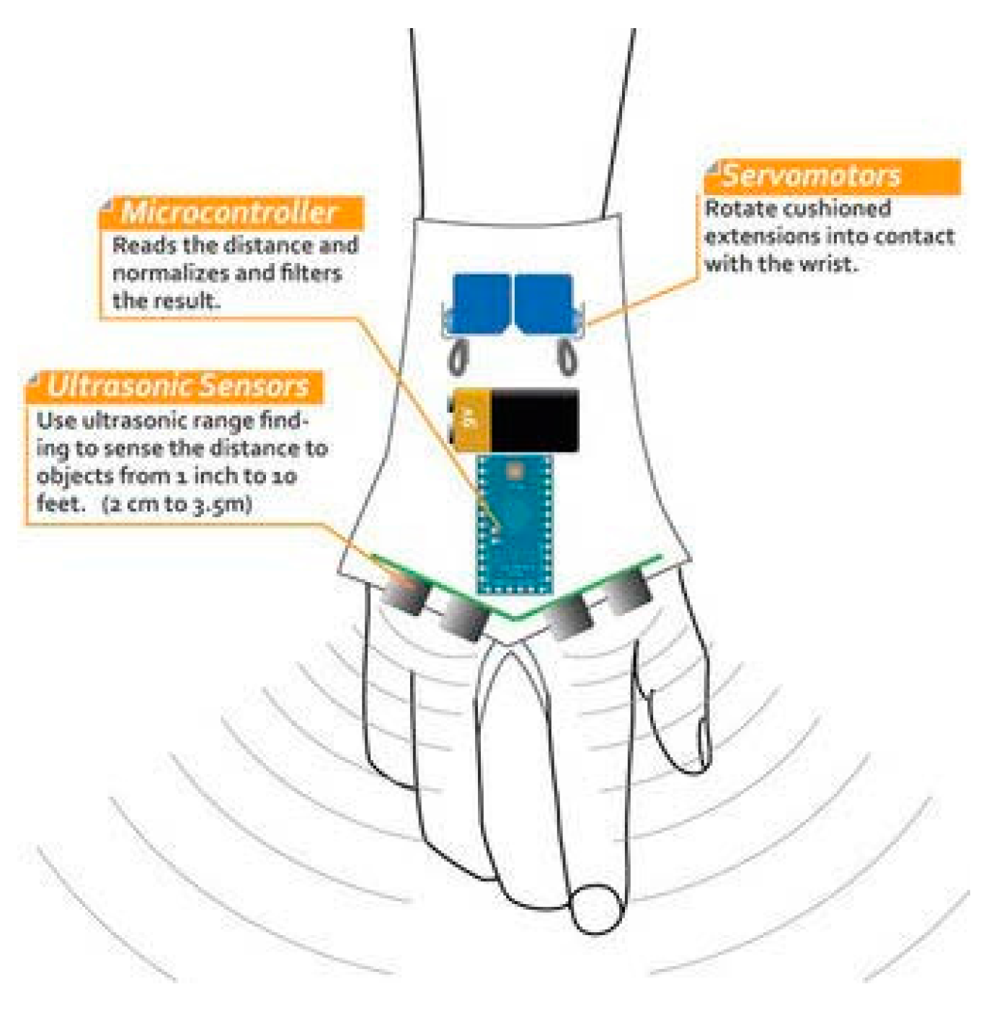
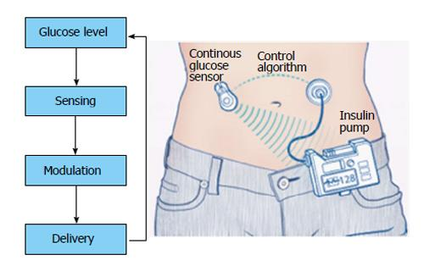



BIOEN 498/599: Biomedical Control Systems Engineering
Winter, 2025. MW 2:30-3:50.
Instructor: Joseph L. Hellerstein, Senior Fellow (eScience Institute), Affiliate Professor (Allen School of Computer Science)
jlheller@uw.edu
Bioreactor Control
Medical Device Control
Insulin Control
Closed loop design (control engineering) is essential to building robust systems from biochemical pathways and other open loop biological components that: regulate outputs to a setpoint; ensure stability; and minimize oscillations. This course teaches the essentials of closed loop design using mechanistic models of biochemical systems. Students will acquire the following skills:
determine appropriate control objectives for a closed loop system;
characterize the time domain behavior of a biological system;
develop closed loop architectures that make use of PID controllers, filters, and techniques for compensating biochemical systems;
computational techniques for finding designs that satisfy control objectives.
Students should have prior experience with programming in python (e.g., BIOEN 336, 437/537).

Slide 2

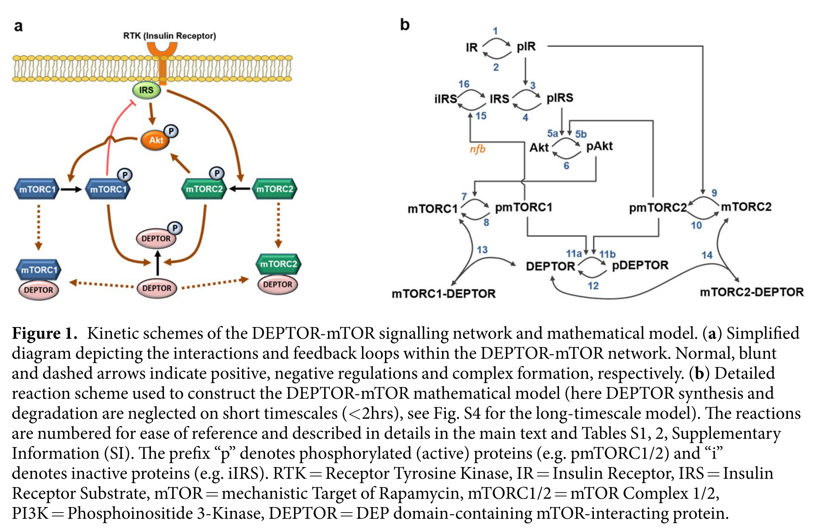
An Example: mTOR Signaling

Slide 3
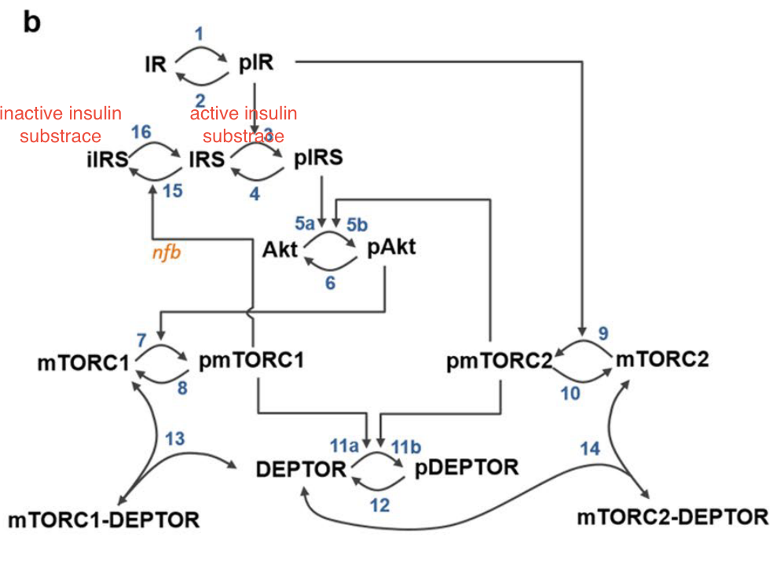
BioChemical OLS
$$J_{1}$$
Inputs (u)
Outputs (y)
mTOR
pIRS,
Akt
pmTORC1, J7
$$J_{12}$$
Inputs: Changes in species concentrations, kinetic constants
Outputs: Concentrations of floating chemical species, reaction fluxes
Must either be a state or computable from the states (e.g., conserved species, assignment statements)

Slide 4





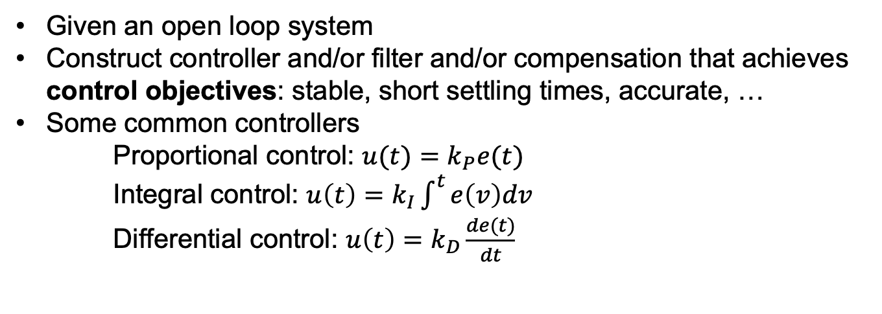


Control Engineering
$$r(t)$$
$$e(t)$$
$$u(t)$$
$$y(t)$$
Controller
C
+
$$OLS$$
+
$$−$$
$$Filter$$
Given an open loop system
Construct controller and/or filter and/or compensation that achieves control objectives: stable, short settling times, accurate, …
Some common controllers
Proportional control: $u(t)=k_{P}e(t)$
Integral control: $u\left(t\right)=k_{I}\int^{t}{e\left(v\right)dv}$
Differential control: $u\left(t\right)=k_{D}\frac{de(t)}{dt}$
Notes:
Why doesn’t a filter help with measurement noise? Verify transfer functions.

Slide 5
Challenges in Control Engineering of Biological Systems
Homeostasis is not our friend.
Can be difficult to find an input that affects the output
Complex activation and inhibition makes it difficult to know the direction of effects
Difficult to accurately model biological systems.

Slide 6
Exploring Feedback Control
Design for regulation
Effect of kP on stability, oscillations
Bias
Removing bias by adjusting the reference

Slide 7
BACKUP

Slide 8











Closed Loop System (CLS)
$$r(t)$$
$$e(t)$$
$$u(t)$$
$$y(t)$$
Controller
+
$$OLS$$
+
$$−$$
$$Filter$$
$$r(t)$$
$$e(t)$$
$$u(t)$$
$$y(t)$$
Controller
+
$$OLS$$
+
$$−$$
Notes:
Why doesn’t a filter help with measurement noise? Verify transfer functions.

